Slide 1
Linear Algebra
Lecture 39

Slide 2
Linear Algebra
Lecture 39

Slide 3
Segment VI
Orthogonality and
Least Squares

Slide 4
Orthogonal
Sets

Slide 5

Definition
A set of vectors {u₁, …, u_{p}} in R^{n} is said to be an orthogonal set if each pair of distinct vectors from the set is orthogonal, i.e.

Slide 6
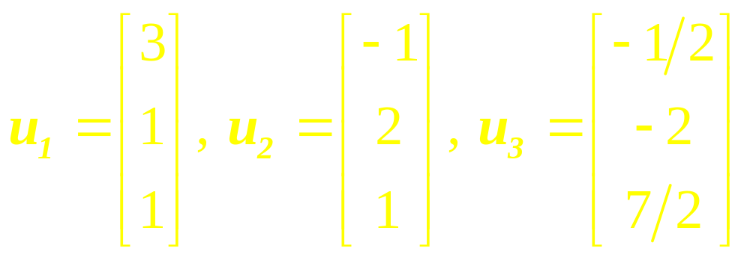
Example 1
Show that {u₁, u₂, u₃} is an orthogonal set, where

Slide 7
Theorem
If S = {u₁, …, u_{p}} is an orthogonal set of nonzero vectors in R^{n}, then S is linearly independent and hence is a basis for the subspace spanned by S.
…

Slide 8
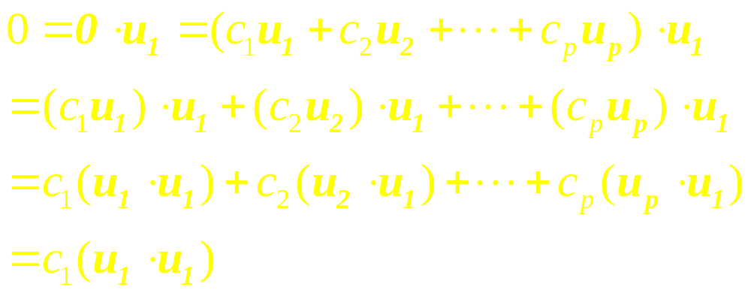
Proof
If 0 = c₁u₁ +…+c_{p}u_{p} for some scalars c₁, …, c_{p}, then
…

Slide 9
Continued
Since u₁ is nonzero, u₁.u₁ is not zero and so c₁= 0.
Similarly, c₂, …, c_{p} must be zero. Thus S is linearly independent.

Slide 10
Definition
An orthogonal basis for a subspace W of R^{n} is a basis for W that is also an orthogonal set.

Slide 11
Theorem
Let {u₁, …, u_{p}} be an orthogonal basis for a subspace W of R^{n}. Then each y in W has a unique representation as a linear combination of u₁, …, u_{p}.
…

Slide 12


Continued
In fact, if
…

Slide 13
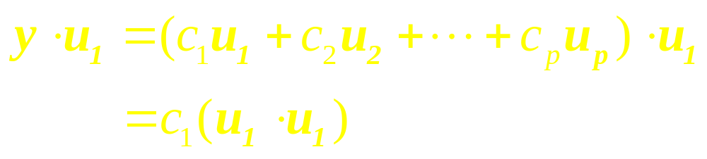
Proof
Since u₁.u₁ is not zero, the equation above can be solved for c₁. To find c_{j} for j = 2, …, p, compute y.u_{j} and solve for c_{j}.

Slide 14
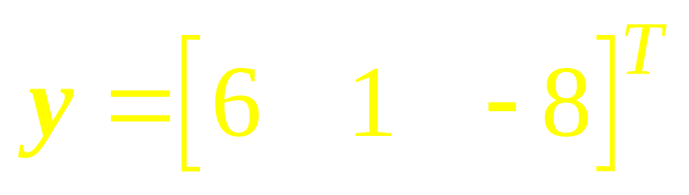
Example 2
The set S = {u₁, u₂, u₃} as in Ex.1 is an orthogonal basis for R³. Express the vector y as a linear combination of the vectors in S, where
…

Slide 15
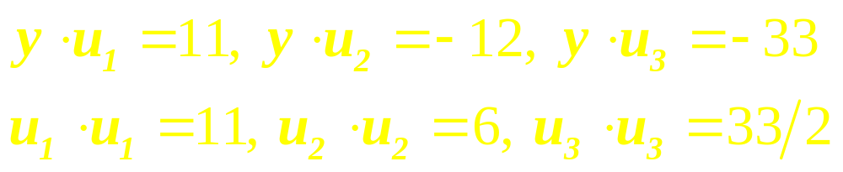
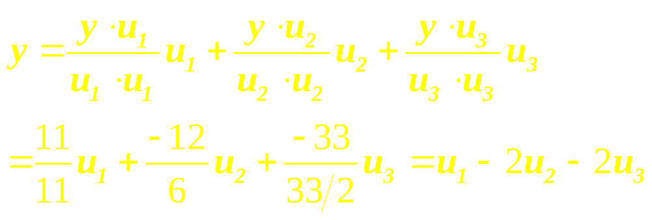
Solution

Slide 16
Orthogonal
Projection

Slide 17
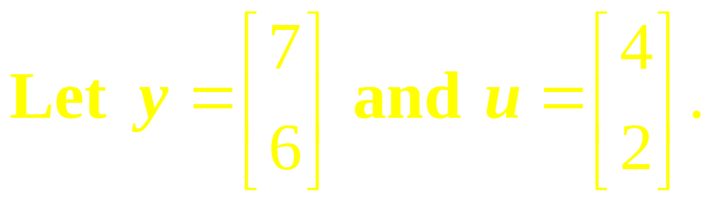
Example 3
Find the orthogonal projection of y onto u. Then write y as the sum of two orthogonal vectors, one in Span {u} and one orthogonal to u.
…

Slide 18

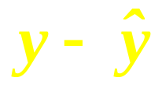

Example 4
Find the distance in Figure below from y to L.
x₂
y
L= Span {u}
2
u
x₁
1
8

Slide 19

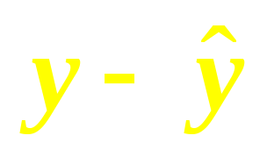

Solution
The distance from y to L is the length of the perpendicular line segment from y to the orthogonal projection .
This length equals the length of . Thus the distance is

Slide 20
Orthonormal Sets
A set {u₁, …, u_{p}} is an Orthonormal set if it is an orthogonal set of unit vectors.

Slide 21
Orthonormal Basis
If W is the subspace spanned by an orthonormal set
{u₁, …, u_{p}}, then it is an Orthonormal basis for W

Slide 22
Example
The simplest example of an Orthonormal set is the standard basis {e₁, …, e_{n}} for R^{n}. Any nonempty subset of {e₁, …, e_{n}} is orthonormal, too.

Slide 23
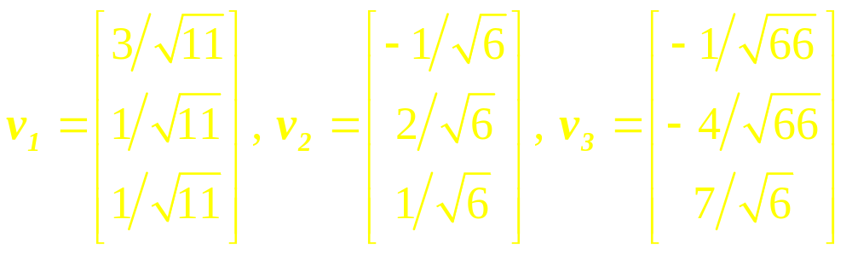
Example 5
Show that {v₁, v₂, v₃} is an orthonormal basis of R³,
where

Slide 24
Theorem
An m x n matrix U has orthonormal columns iff
U^{T}U = I.

Slide 25
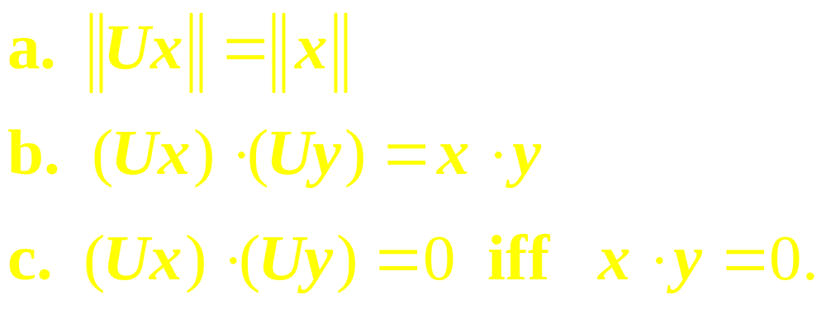
Theorem
Let U be an m x n matrix with orthonormal columns, and let x and y be in R^{n}. Then

Slide 26
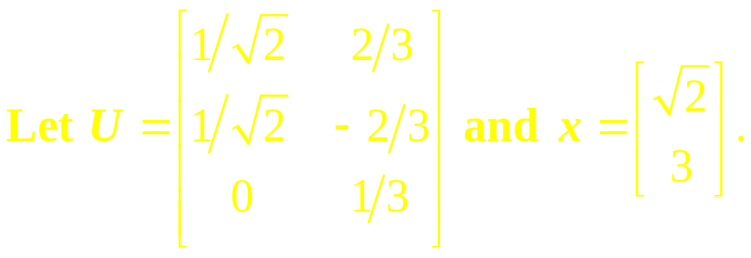

Example 6
…

Slide 27
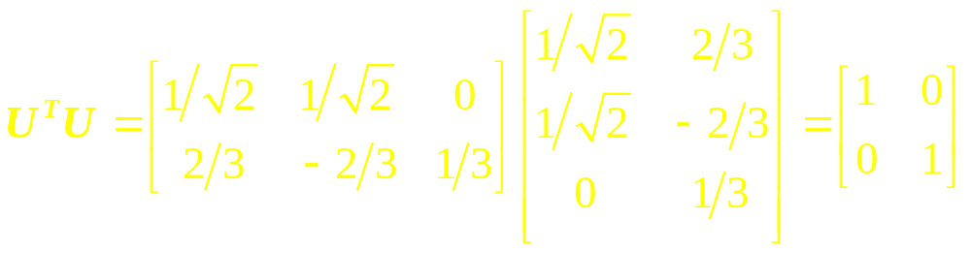
Solution
Notice that U has orthonormal columns and
…

Slide 28
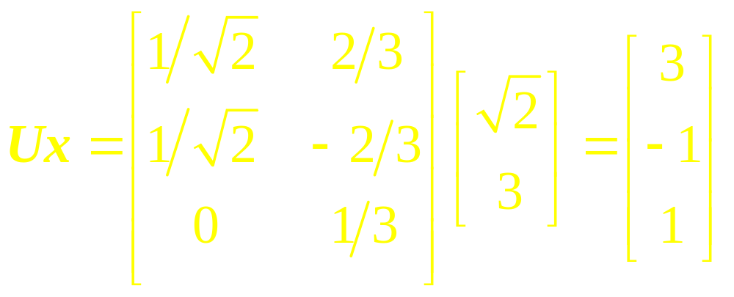

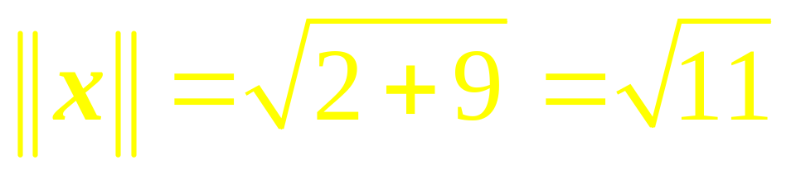
Continued

Slide 29
Linear Algebra
Lecture 39

